Slide 1
Met Office ESMValTool Update
Progress on the Climate Model Evaluation Workflow (CMEW) and the Recipe Test Workflow (RTW)

Slide 2
The Climate Model Evaluation Workflow
CAW
The Climate Model Evaluation Workflow (CMEW; sounds like emu) is the name given to the workflow that will replace the bespoke, internal tools currently used to perform climate model evaluation at the Met Office
CMEW aims to consolidate climate model evaluation of all ESM components (atmosphere, ocean, sea ice, land, …) by using ESMValTool
CMEW will:
minimise complexity
simplify future porting work
[Credit for the name CMEW goes to Ed Blockley!]

Slide 3
CMEW technical information
CAW
CMEW:
is stored in MetOffice/CMEW (private for now) on GitHub
uses Rose 2 and Cylc 8
uses ESMValTool experimental config API
has been developed to ensure a portable workflow
uses our centrally managed ESMValTool environments

Slide 4
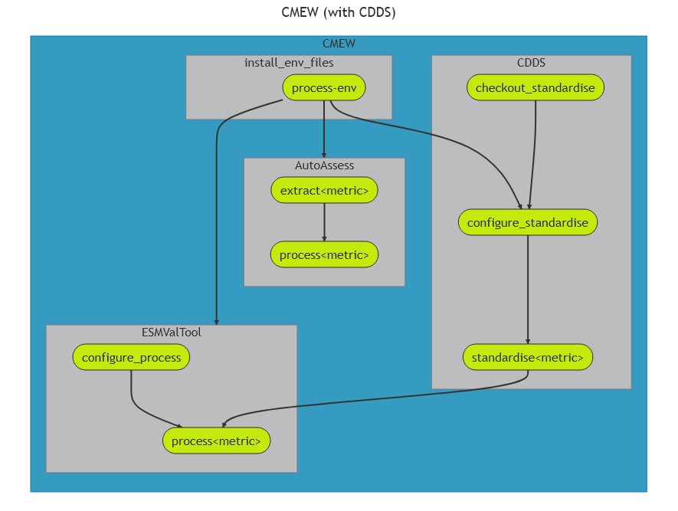
Structure of CMEW?
Notes:
Explain the concept of 'sites' - a configurable file that enables running of CMEW/RTW on MO Hardware, Jasmin or any other environment. Install_env_files sets up this site specific run information.
CDDS standardises model output by interpreting and combining our stash codes into CMIP variables.

Slide 5
The plan
CAW
Create a prototype to demonstrate how an ESMValTool metric and an AutoAssess metric can be run from a single workflow
Add all un-converted AutoAssess metrics to CMEW
Retire the AutoAssess Rose suite

Slide 6
Future
Expect activity from MO scientists in February! We'll be working with scientists to convert AutoAssess metrics to ESMValTool.

Slide 7
CMEW Summary
Using the ESMValTool (ex-experimental) config API
Developing a prototype
Activity from MO Scientists starting February 2024

Slide 8
Recipe Test Workflow

Slide 9
What is the Recipe Test Workflow (RTW)?
Cylc 8 workflow
Also uses 'sites' to enable running on Jasmin/DKRZ/MO Linux Estate
Used to run recipes regularly
Frequency with which recipes are run is based on how computationally expensive they are, or how long they take to run.
Recipes only request the resources that they need.
Will help discover breaking changes before the rush to release.

Slide 10
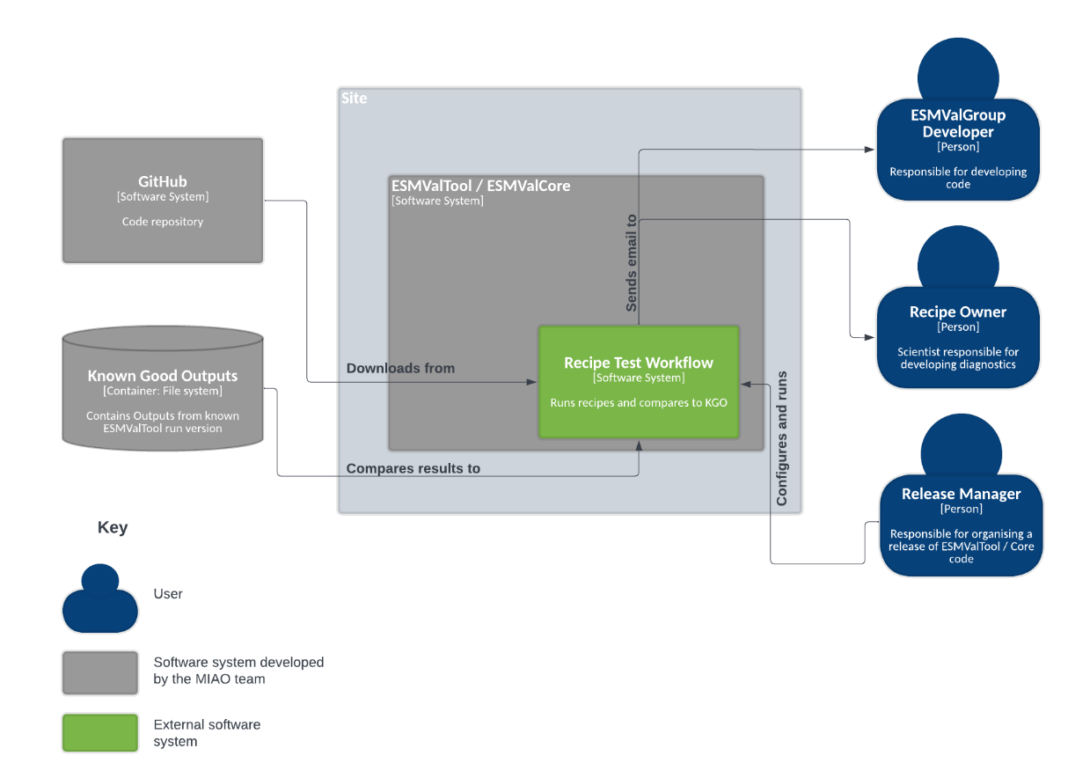
RTW: Context Diagram

Slide 11
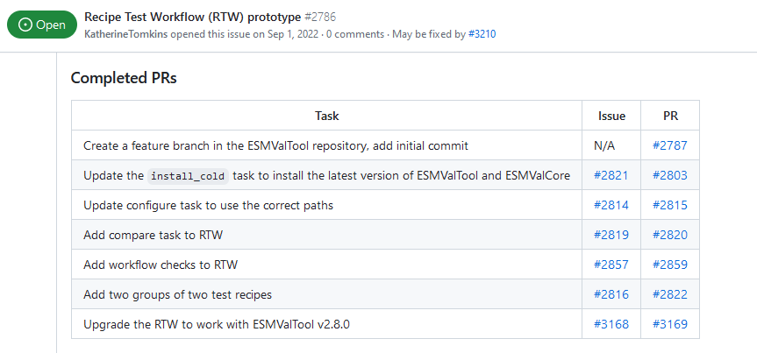
RTW: Current status

Slide 12
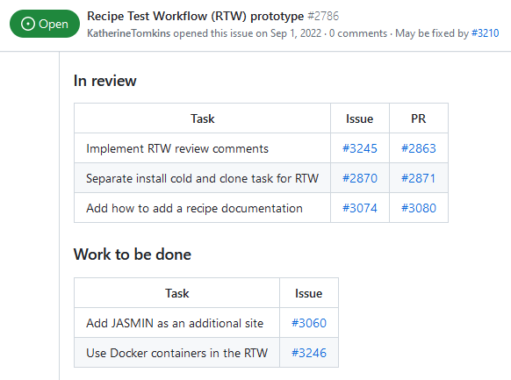
Items to complete before community review
Can someone help us with this, please? :)

Slide 13
Prompt for discussion
Known Good Outputs:
How do we manage them?
Where do we store them?
KGOs may differ from site to site, do we need a tolerance check?
We need your input! See ESMValTool: Discussion: #3247

Slide 14
Ideas for improvement
Some recipes aren't reproducible
If we want to use them in the RTW, this will need resolving.
Is making them reproducible worth saving the effort of checking them manually at release time?
We need your input! See ESMValTool: Discussion: #3248

Slide 15
Post-prototype feature requests / discussion
Automatically open a GitHub issue (with the RTW label) when something breaks
Any more ideas?
We need your input! See ESMValTool: Discussion: #3249

